Slide 1
Computing and Rendering Point Set Surfaces Review
Presenter:
Jiatao Fan
Article authors:
Marc Alexa (TU Darmstadt),
Johannes Behr (ZGDV Darmstadt)
Daniel Cohen-Or (Tel Aviv University),
Shachar Fleishman (Tel Aviv University),
David Levin (Tel Aviv University),
Claudio T. Silva (AT&T Labs)

Slide 2
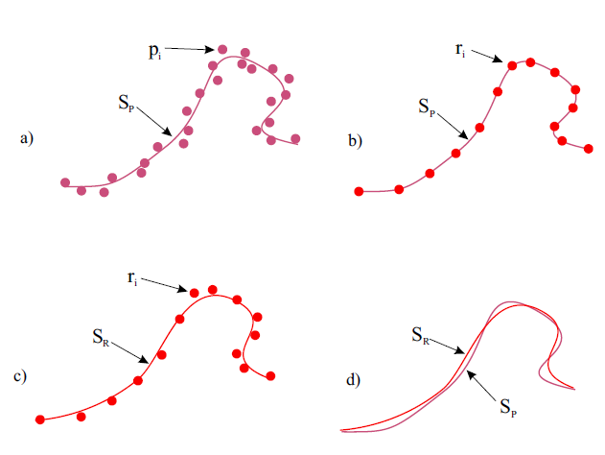
Goal
To use a smooth manifold surface from a set of points to represent a surface close to an original surface

Slide 3

1. Key Definitions
Smooth manifold:
The surface defined by the point set is a 2-manifold and expected to be $C^{∞}$ smooth, given that the points are sufficiently close to the smooth surface being represented.

Slide 4

1. Key Definitions
Bounded sampling error:
Let${ S}_{R}$be defined by the set of representation points and ${ S}_{P}$ be the original surface. The representation has bounded error Ɛ, if d(${ S}_{P}$, ${ S}_{R}$) < Ɛ, where d(·, ·) is the Hausdorff distance.

Slide 5
1. Key Definitions
Local computation:
For computing a point on the surface only a local neighborhood of that point is required.
Result:
Small memory footprint
Depends only on the anticipated feature size and not the number of points.

Slide 6
1. Key Definitions
High quality:
Since the surface defined by the point set is a smooth surface, proper re-sampling leads to smooth silhouettes and normals resulting in superior rendering quality at interactive frame rates.

Slide 7
1. Key Definitions
Single step procedure :
Re-sampling respects screen space resolution and guarantees sufficient sampling, i.e. no holes have to be filled in a post-processing step.

Slide 8
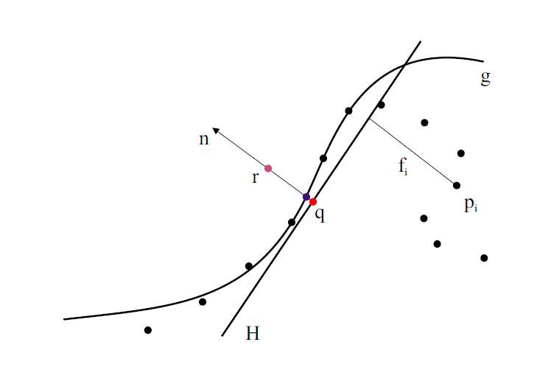
2. Defining the Surface – projecting
First, a local reference domain H for the purple point r is generated. The projection of r onto H defines its origin q (the red point).

Slide 9
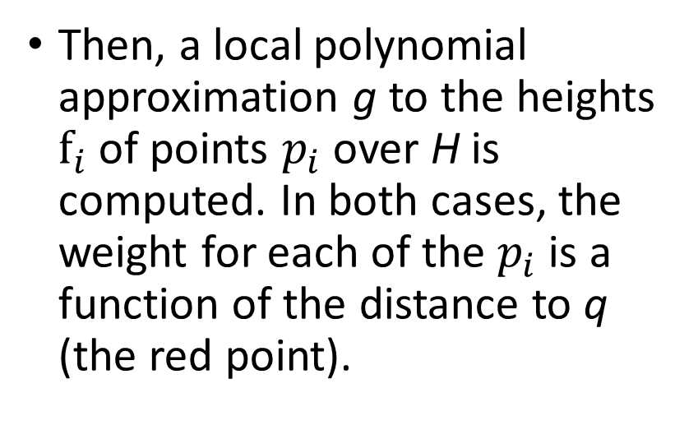
2. Defining the Surface – projecting
Then, a local polynomial approximation g to the heights $f_{i}$ of points $p_{i}$ over H is computed. In both cases, the weight for each of the $p_{i}$ is a function of the distance to q (the red point).

Slide 10
2. Defining the Surface – projecting
The projection of r onto g (the blue point) is the result of the MLS projection procedure.

Slide 11
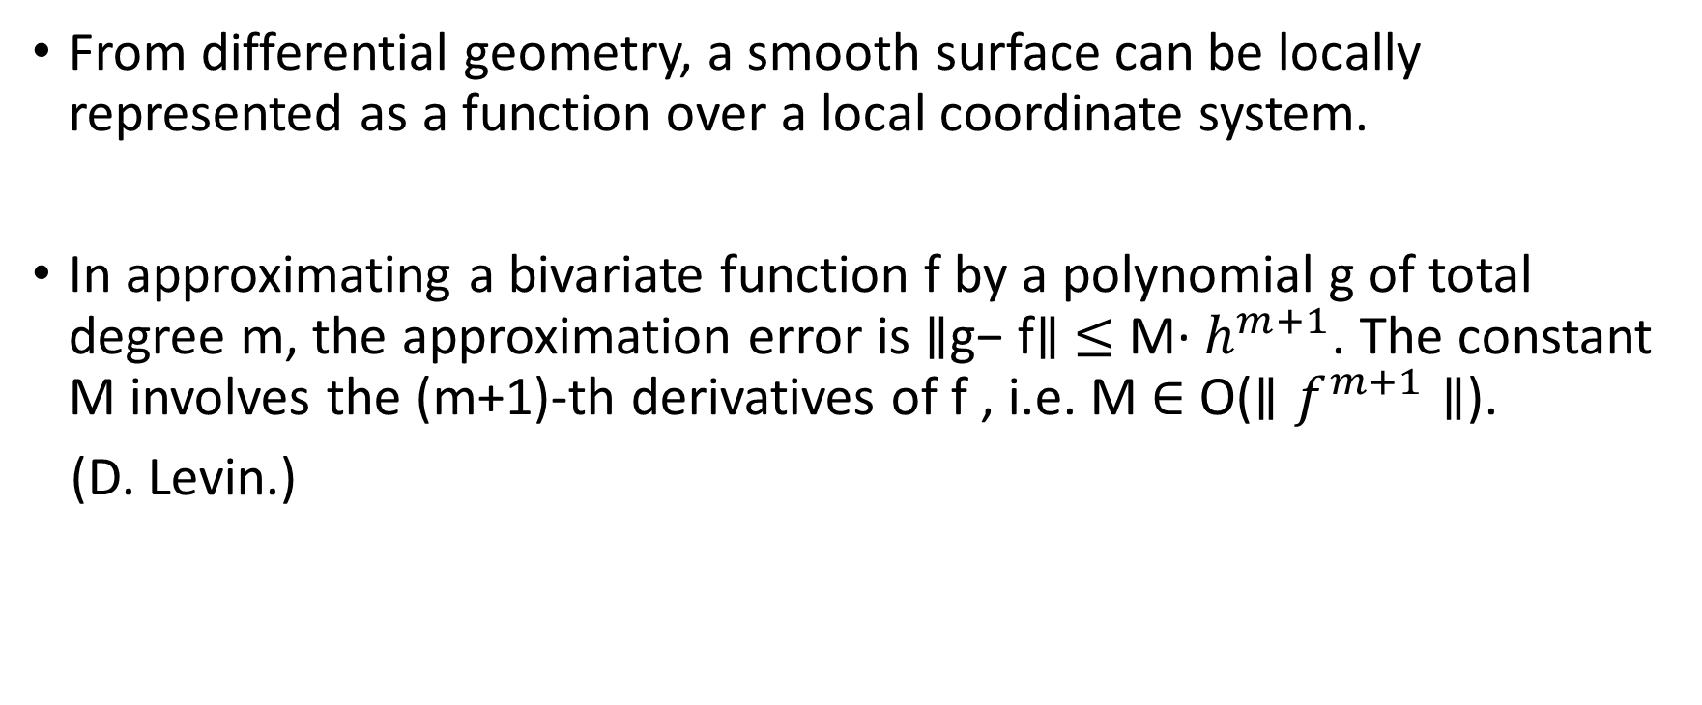
3. Bounded Approximation Error
From differential geometry, a smooth surface can be locally represented as a function over a local coordinate system.
In approximating a bivariate function f by a polynomial g of total degree m, the approximation error is $∥$g− f$∥$ $≤$ M· $h^{m+1}$. The constant M involves the (m+1)-th derivatives of f , i.e. M $∈$ O($∥f^{m+1}∥$).
(D. Levin.)

Slide 12
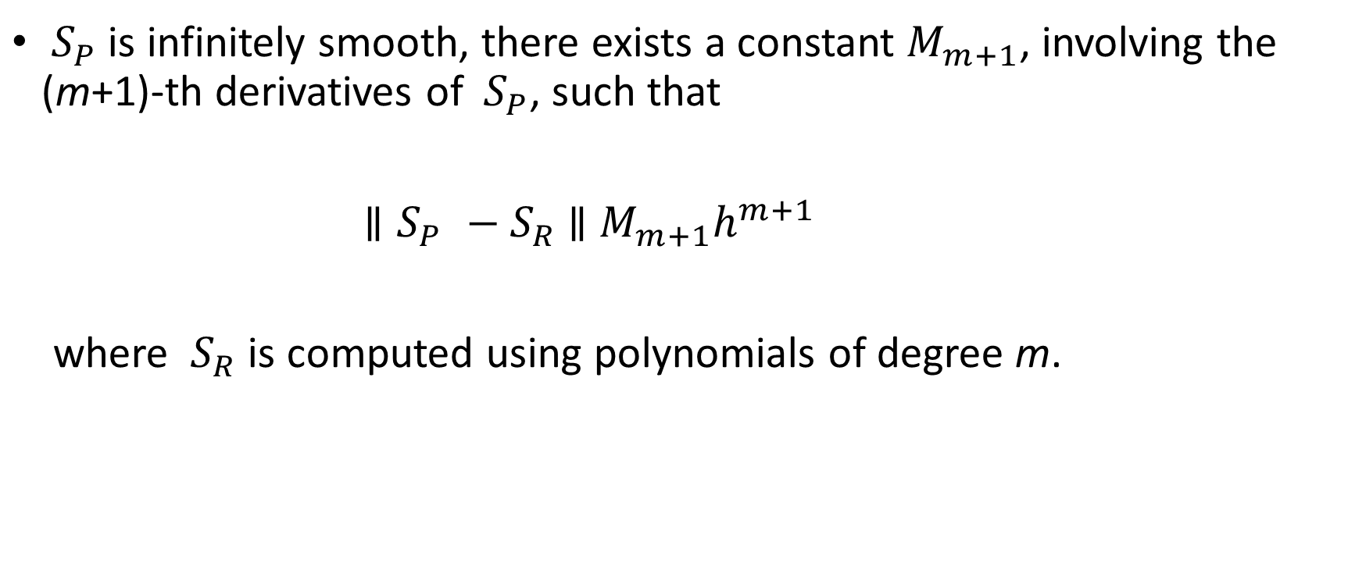
3. Bounded Approximation Error
${ S}_{P}$ is infinitely smooth, there exists a constant $M_{m+1}$, involving the (m+1)-th derivatives of ${ S}_{P}$, such that
${∥S}_{P} −{ S}_{R}$ $∥$ $M_{m+1}h^{m+1}$
where ${ S}_{R}$ is computed using polynomials of degree m.

Slide 13
4. Generating the Representation Point Set
A given point set might have
erroneous point locations (noise)
too many points (redundance)
not enough points (under-sampling)

Slide 14
4 .Generating the Representation Point Set
Solutions:
Noise
Project the points onto the MLS surface they define. The result of the projection procedure is a thin point set.
Redundancy
Decimating the point set, maintaining a good approximation of the MLS surface defined by the original point set.
Under-sampling
The input point set needs to be up-sampled.

Slide 15
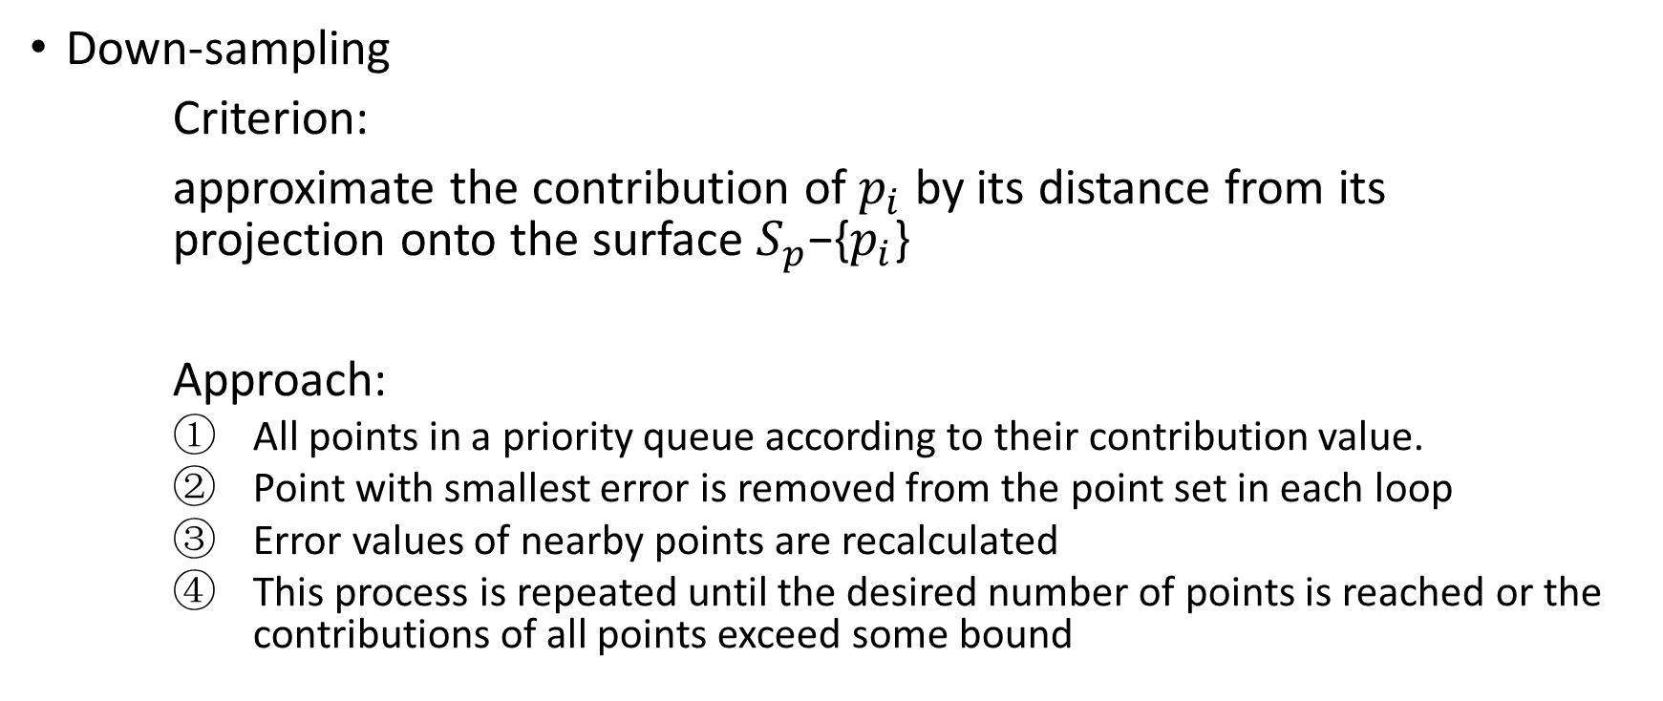
4 .Generating the Representation Point Set
Down-sampling
Criterion:
approximate the contribution of $p_{i}$ by its distance from its projection onto the surface $S_{p}$−{$p_{i}$}
Approach:
All points in a priority queue according to their contribution value.
Point with smallest error is removed from the point set in each loop
Error values of nearby points are recalculated
This process is repeated until the desired number of points is reached or the contributions of all points exceed some bound

Slide 16
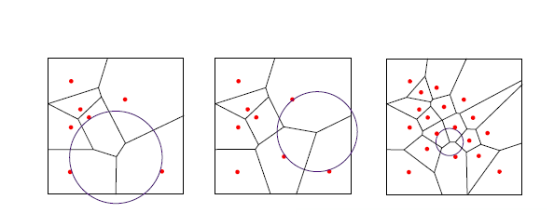
4 .Generating the Representation Point Set
Up-sampling
Points are added at vertices of the Voronoi diagram. In each step, the vertex with the largest empty circle is chosen. The process is repeated until the radius of the largest circle is smaller than a specified bound.

Slide 17
5 .Rendering
Typically, points are not dense enough to be projected directly as a single pixel and more points need to be generated by interpolation in object space.
Solution: Sample the polynomials associated with the representation points rather than really projecting the points

Slide 18
5 .Rendering
To render such surfaces, the surface is covered by a finite number, as small as possible, of non-conforming, overlapping, polynomial patches.
The error of these approximations is bounded and dependent on the spacing among points.

Slide 19
Conclusion
Concept of representing shapes with point sets
A framework to approximate a smooth surface defined by a set of points
New techniques to resample the surface
Methods to generate an adequate representation of the surface

